Slide 1
Organic Chemistry
Pearson & Essential Text book

Slide 2
Introduction
All living things on earth are formed mostly of carbon compounds. “carbon-based” life on earth.
Organic chemistry is the study of the chemistry of carbon compounds. Carbon is singled out because it has a chemical diversity. Its diversity is based on the following:
Carbon atoms bond reasonably strongly with other carbon atoms.
Carbon atoms bond reasonably strongly with atoms of other elements.
Carbon atoms make a large number of covalent bonds (four).

Slide 3
Introduction contd.
Today, organic compounds are key components of plastics, soaps, perfumes, sweeteners, fabrics, pharmaceuticals, and many other substances that we use every day.
Some carbon-containing compounds are not classified as organic, for example, carbonates and cyanides, and simple oxides, such as CO and CO₂.

Slide 4
ORGANIC COMPOUNDS
COMPOUNDS CONTAINING CARBONS EXCEPT CARBON MONOXIDE, CARBON DIOXIDE, METAL CARBONATES & HYDROCARBONATES, CARBIDES.
CARBONS FORMS A VAST NUMBER OF DIFFERENT COMPOUNDS BECAUSE OF ITS ABILITY TO FORM CHAINS CONTAINING A SUCCESSION OF CARBON - CARBON BONDS. Catenation
CARBON CAN FORM CARBON-CARBON SINGLE, DOUBLE AND TRIPLE BONDS.
CARBON – CARBON SINGLE BOND (TETRAHEDRAL SHAPE)
CARBON – CARBON DOUBLE BOND (TRIGONAL PLANAR SHAPE)
CARBON – CARBON TRIPLE BOND (LENEAR SHAPE)

Slide 5
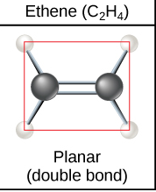
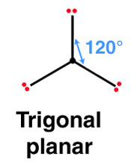
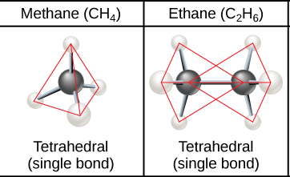
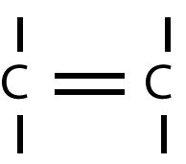
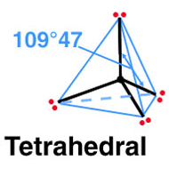
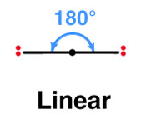
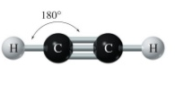
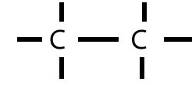

Bonding and geometry of carbon molecules

Slide 6
Families of Organic Molecules: Functional Groups
Organic compounds can be classified into families according to structural features.
The chemical behavior of family members is often predictable based on their specific grouping of atoms.
The structural features that allow classification of organic compounds into families are called functional groups.
A Functional group is an atom or group of atoms within a molecule that has a characteristic physical and chemical behavior.
A given functional group tends to undergo the same reactions in every molecule that contains it.

Slide 7
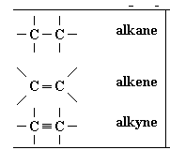
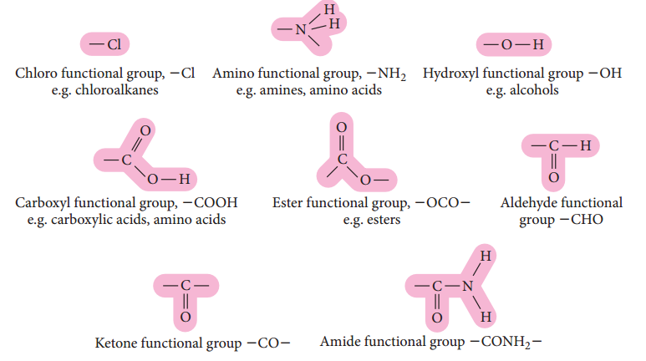
Functional Groups

Slide 8
HYDROCARBONS
COMPOUNDS CONTAINING CARBON AND HYDROGEN ONLY.
GENERAL FORMULA
HYDROCARBONS CAN CONTAIN C – C SINGLE, DOUBLE OR TRIPLE BONDS.
C – C SINGLE BONDS ONLY – SATURATED HYDROCARBONS
C – C DOUBLE OR TRIPLE BONDS – UNSATURATED HYDROCARBONS
HYDROCARBONS CAN ALSO BE
STRAIGHT CHAIN
BRANCHED CHAIN
CYCLIC

Slide 9
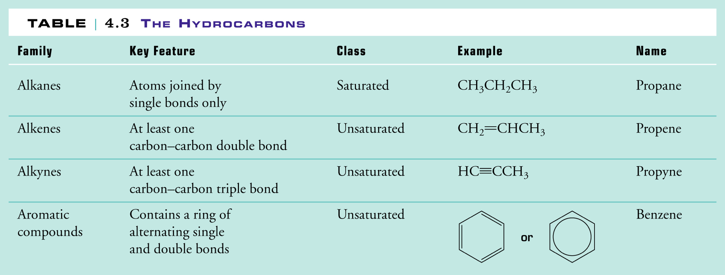
Hydrocarbons

Slide 10
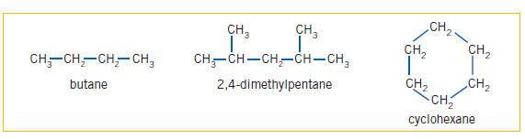
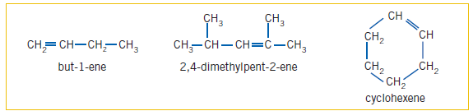
EXAMPLES OF HYDROCARBONS

Slide 11
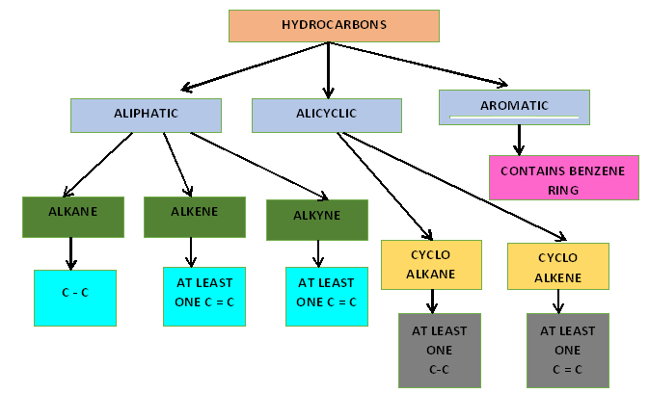
CLASSIFICATION OF HYDROCARBONS

Slide 12
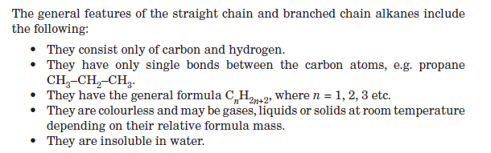
ALKANES

Slide 13
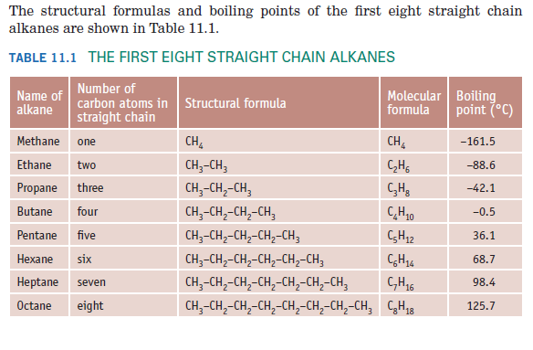

Slide 14
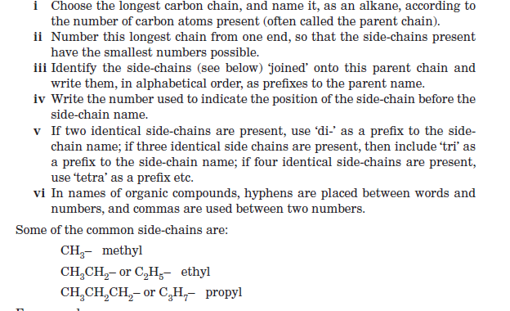
NAMING – IUPAC RULES

Slide 15
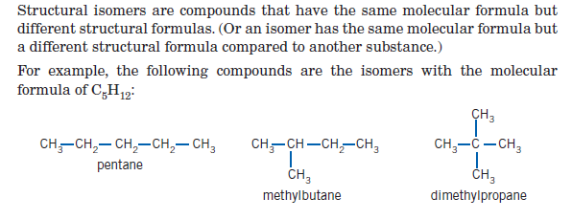
STRUCTURAL ISOMERS OF ALKANES

Slide 16
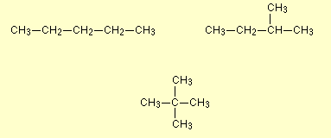
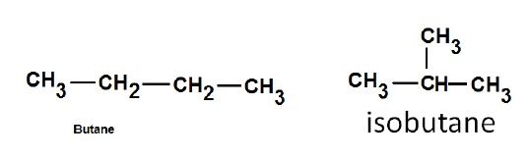
Types of structural isomerism
Chain isomerism
These isomers arise because of the possibility of branching in carbon chains. For example, there are two isomers of butane, C₄H₁₀. In one of them, the carbon atoms lie in a "straight chain" whereas in the other the chain is branched.

Slide 17
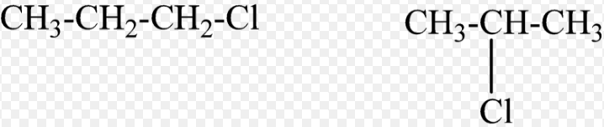
Position Isomers
In position isomerism, the basic carbon skeleton remains unchanged, but important groups are moved around on that skeleton.
For example, there are two structural isomers with the molecular formula C₃H₇Cl. In one of them the Chlorine atom is on the end of the chain, whereas in the other it's attached in the middle.

Slide 18
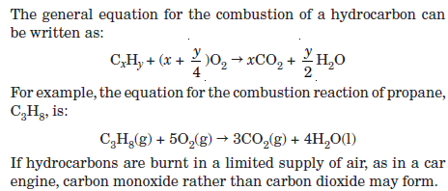
REACTIONS OF ALKANES - COMBUSTION

Slide 19
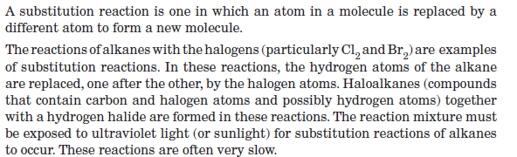
REACTIONS OF ALKANES – SUBSTITUTION

Slide 20
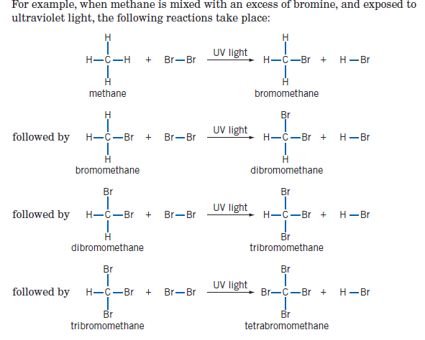
SUBSTITUTION – EXAMPLE

Slide 21
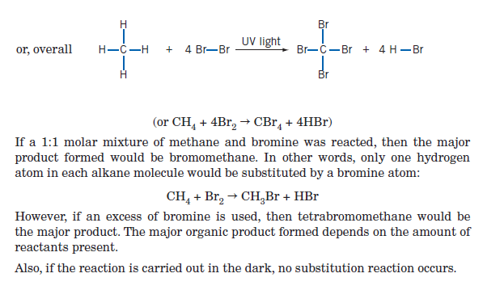
SUBSTITUTION – CONTIND…

Slide 22
Alkenes
Alkenes have the following general properties.
• They contain only carbon and hydrogen atoms.
• They have at least one double carbon–carbon bond, for example, propene,
CH2=CH–CH3, is an alkene.
• They have a general formula of C_{n}H_{2n} where n = 1, 2, 3 etc. (Assuming the alkene has only one double bond.)
• They are colourless compounds.
• They have relatively low melting and boiling points.
• They are insoluble in water.

Slide 23
Naming alkenes
Alkenes are named in much the same way as alkanes, except for the following.
The longest carbon chain chosen as the parent chain must contain the double carbon–carbon bond.
This parent chain is numbered from the end that gives the double bond the smallest number possible.
The suffi x ‘-ene’ is used as the ending of the parent name, rather than ‘-ane’.
The position of the double bond within the chain is given as the lower number of the two double bonded carbons. The number is placed just before the suffi x ‘-ene’.

Slide 24
Practice naming

Slide 25
Isomerism

Slide 26
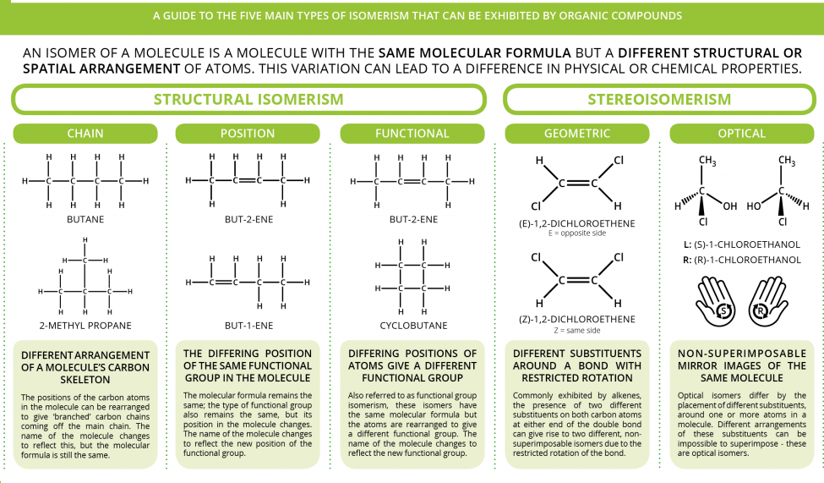

Slide 27
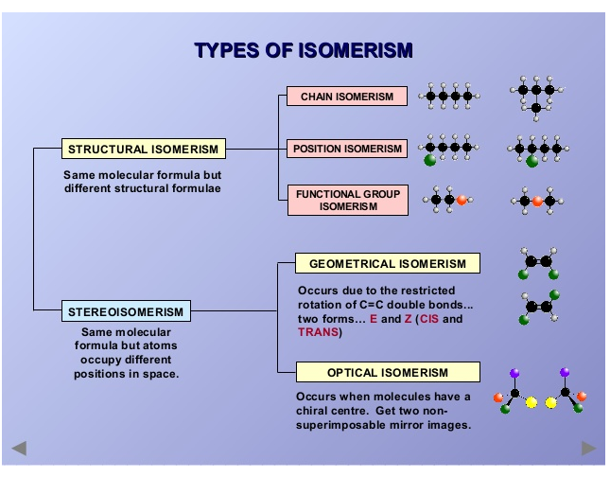
Isomerism

Slide 28
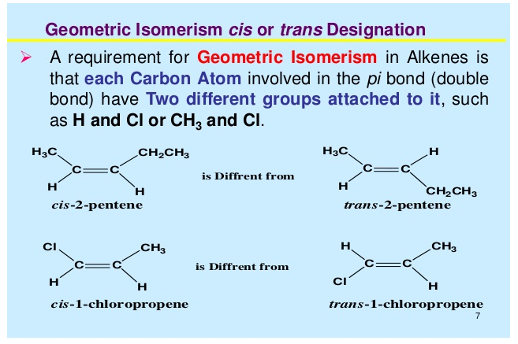
Geometric isomerism

Slide 29
Practice questions
will these compound show geometrical isomerism
Question- draw all the isomers of C₄H₈

Slide 30
Reaction of Alkenes
Addition reactions- Note: Double bond becomes a single bond.
Hydrogenation- addition of H₂
Halogenation-addition of Halogens
Hydrohalogenation- addition of hydrogen and halogens
Hydration- addition of water.
Substitution reaction.

Slide 31
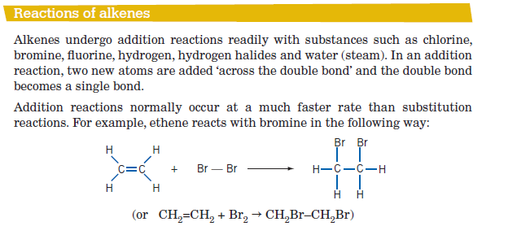
Alkenes Reactions

Slide 32
Addition of H₂
Double bond is broken
H atom added to both sides of double bond
Platinum, palladium, or nickel catalyst required
Heat and/or pressure may also be needed
Product is an Alkane.

Slide 33
Examples of Hydrogenation
Hydrogenation of propene to propane
Hydrogenation of trans-2-butene

Slide 34
Addition of halogen X₂
This reaction occurs easily and does not require a catalyst.

Slide 35
Examples of Halogenation
Bromination of 1-propene to form 1,2-dibromopropane
Chlorination of trans-2-butene to form 2,3-dichlorobutane

Slide 36
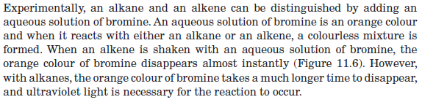
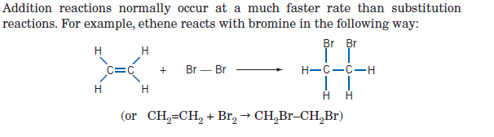
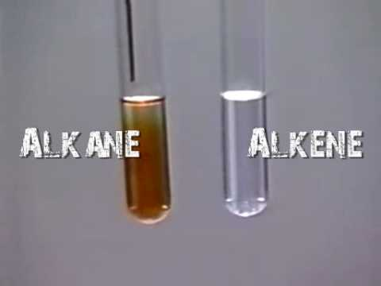
Difference between alkanes and alkenes

Slide 37
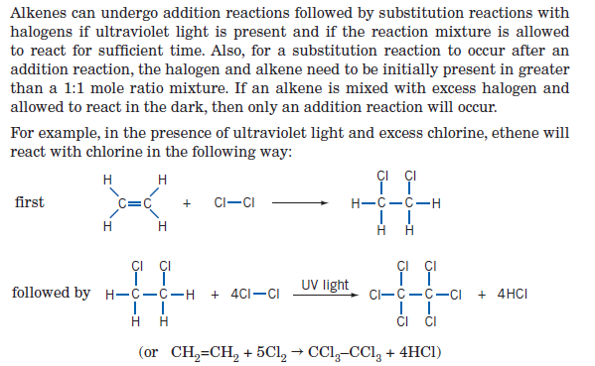
Substitution reaction of alkenes

Slide 38
Hydration: Addition of H2O
Requires a trace of acid (H+) as a catalyst
The product is an alcohol
Markovnikov’s rule applies

Slide 39
Markovnikov’s Rule
A mixture of products is formed when an unsymmetrical alkene is hydrated.
One product is always favored over the other.
Vladimir Markovnikov came up with a rule to determine the major product formed.
The carbon of the carbon-carbon double bond that originally has more hydrogen atoms receives the hydrogen atom being added.
“The rich get richer.”

Slide 40
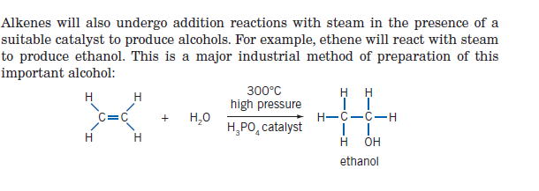
Ethene to ethanol

Slide 41
Example of Markovnikov’s Rule
Hydration of 1-propene to form 2-propanol (major) and 1-propanol (minor)

Slide 42
Hydrohalogenation: Adding HCl or HBr
Follows Markovnikov’s rule

Slide 43
Examples of Hydrohalogenation
Hydrobromination of 1-propene to form 2-bromopropane (major) and 1-bromopropane (minor)

Slide 44
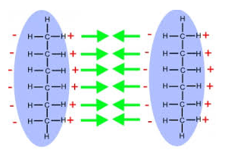
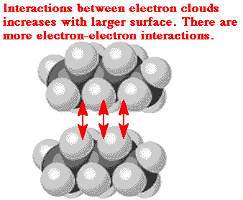
Structure and bonding in hydrocarbons- Physical Properties

Slide 45
Dispersion forces/Van der waals forces
The dispersion force is the weakest intermolecular force.
The dispersion force is a temporary attractive force that results when the electrons in two adjacent atoms occupy positions that make the atoms form temporary dipoles. This force is sometimes called an induced dipole-induced dipole attraction. Dispersion forces are the attractive forces that cause nonpolar substances to condense to liquids and to freeze into solids when the temperature is lowered sufficiently.

Slide 46
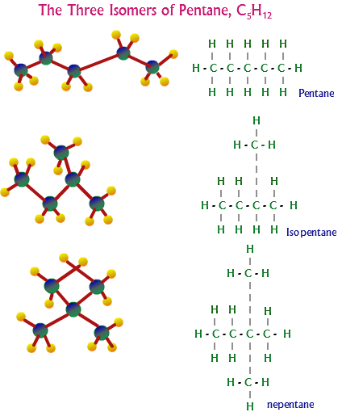
Dispersion forces between molecules in strength with the increase in number of electrons.
They are related to molecular size and mass.
Shape of the molecule also influence the strengths of the dispersion forces.
B.p. of pentane is higher than its isomers, because the overall attraction force is higher in its molecules.
More contact (large surface area) b/w the molecules.

Slide 47
The boiling point of straight-chain alkanes increases with chain length due to increasing van der Waals forces between molecules. As the length of the chain increases, so does its surface area, and so the van der Waals forces are stronger. Branched-chain alkanes have lower boiling points because the chains cannot pack as closely together. There are fewer points of contact between molecules so the van der Waals forces are weaker.

Slide 48
Aromatic hydrocarbons
The term "aromatic" originally referred to their pleasant smells, but now implies a particular sot of delocalised bonding.
The simplest of them is benzene itself, C₆H₆.
Compounds containing a benzene ring are called aromatic compounds. Benzene is the simplest aromatic hydrocarbon.

Slide 49
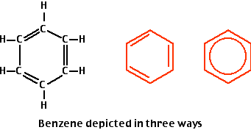
Benzene
Benzene, C₆H₆, is a colourless, highly flammable liquid.
Benzene has a melting point of 5.5ºC and a boiling point of 80ºC.
Insoluble in water.
Benzene is toxic and is known to cause cancer with prolonged exposure.
Benzene is planar molecule (or a flat molecule).
All the carbon-carbon bond angles in benzene are identical, 120º.
Benzene does not readily undergo addition reactions.
Benzene will undergo substitution reactions.

Slide 50
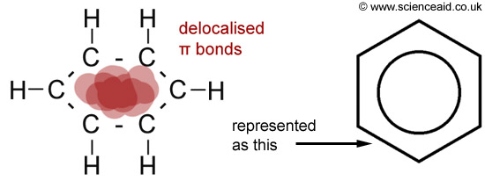
Kekulé Structure
Benzene was known to have the molecular formula C₆H₆, but its structural formula was unknown.
Benzene, C₆H₆, is a planar molecule containing a ring of six carbon atoms each with a hydrogen atom attached.
The six carbon atoms form a perfectly regular hexagon. All the carbon-carbon bonds have exactly the same lengths - somewhere between single and double bonds.
There are delocalised electrons above and below the plane of the ring.

Slide 51
Families of Organic Molecules: Functional Groups
Alcohols- IUPAC Name – 'ol’
Members of the alcohol family contain a hydroxyl group.[ -OH]
The hydroxyl group comprises an oxygen with one single bond to a hydrogen and another single bond to an alkane-type carbon
ethanol
hydroxyl group

Slide 52
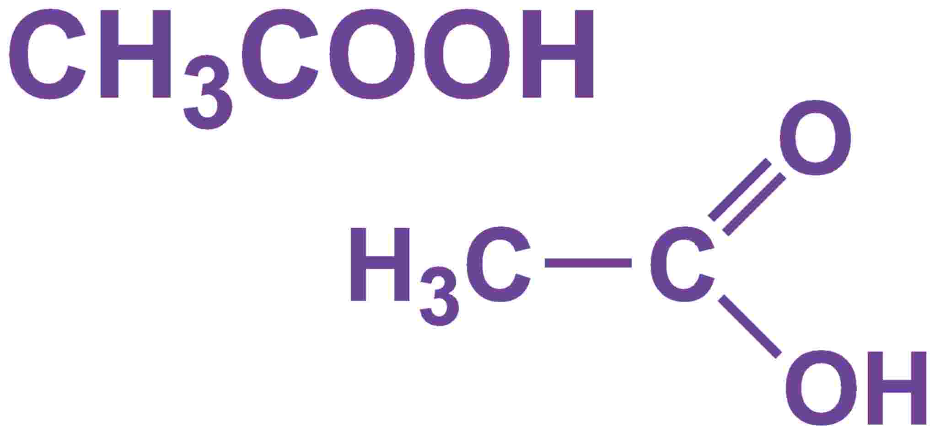
Carboxylic Acids
Carboxylic acids- IUPAC name- ‘oic acid”
Members of the carboxylic acid family contain a carboxylic acid group [-COOH]
The carboxylic acid group comprises a hydroxyl group connected to a carbonyl group:
carboxylic acid group
Ethanoic acid

Slide 53
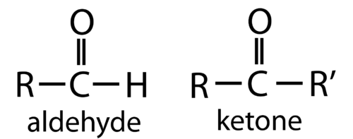
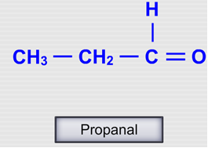
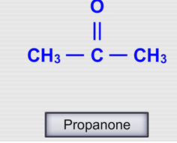
Aldehyde and Ketone
IUPAC name- Aldehyde- ‘-al’, ketone- ‘-one’

Slide 54
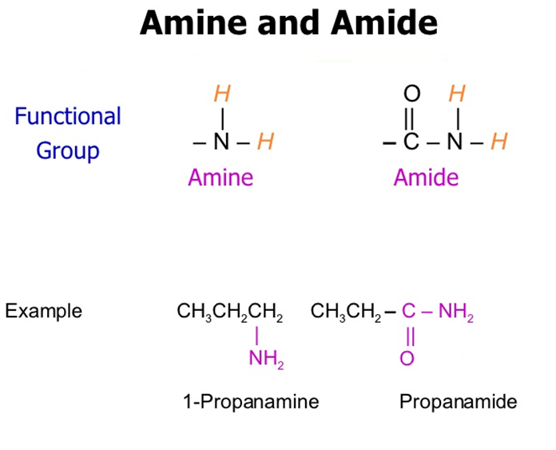
Amine and Amide

